Slide 1
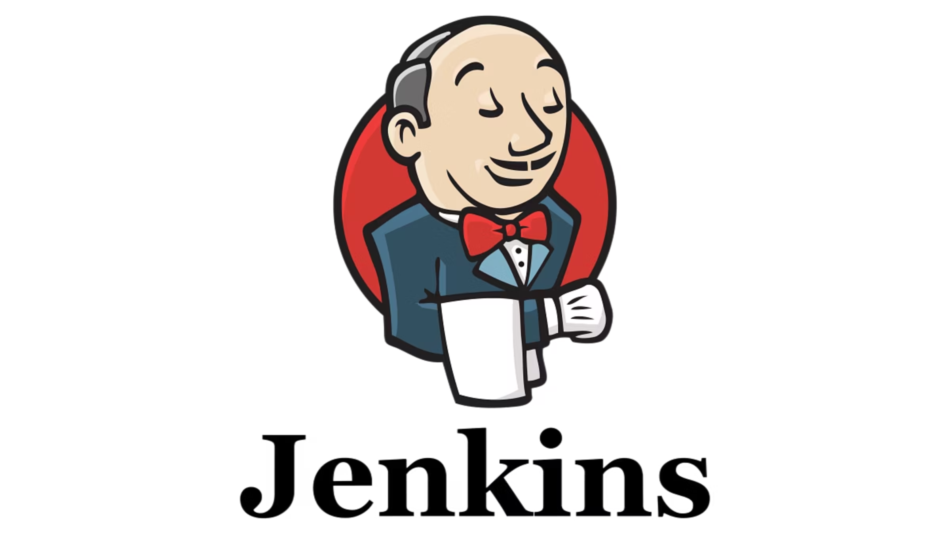
Introduction to Jenkins
Build foundational knowledge of Jenkins, setup, and first pipeline.

Slide 2
What is Jenkins?
1
2
Open-source automation
Streamlined Development
Jenkins is an open-source automation server, freely available and widely used in the industry.
It helps automate the repetitive tasks involved in software development, including building, testing, and deploying code.
3
4
DevOps & CI/CD
Automated Builds
Jenkins is a cornerstone tool for implementing DevOps practices and establishing robust Continuous Integration/Continuous Delivery (CI/CD) pipelines.
For example, Jenkins can be configured to automatically build your application every time a developer pushes new code to a GitHub repository.

Slide 3
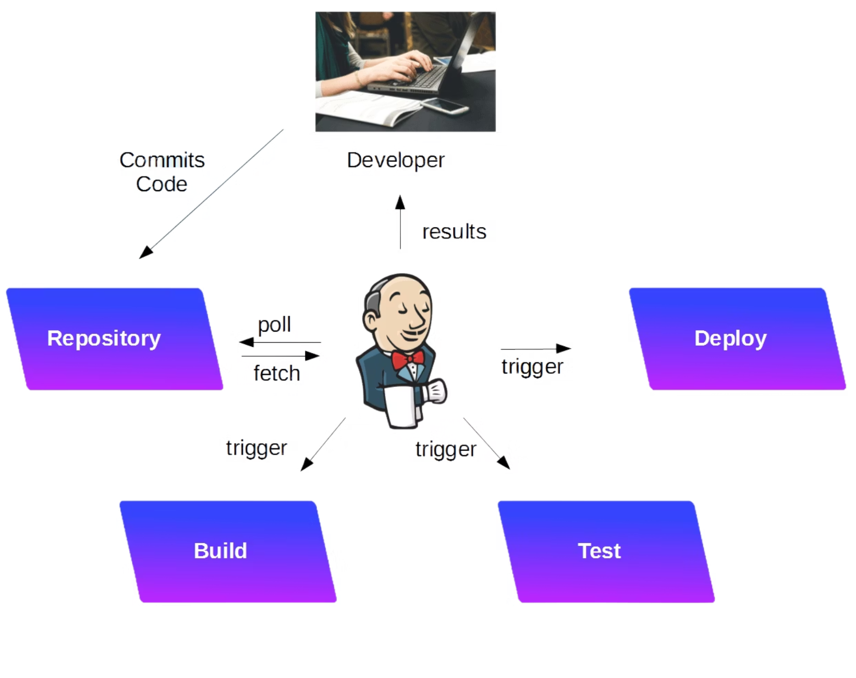

Why Jenkins in DevOps?
Continuous Integration (CI): Jenkins constantly integrates code changes from multiple developers.
Continuous Delivery (CD): Automates the delivery of code to production-ready environments.
Reduced Manual Effort: Significantly cuts down on human intervention, leading to faster and more reliable releases.
Extensive Plugin Ecosystem: Supports over 1,800 plugins, extending its functionality to integrate with almost any tool in your DevOps stack.
Example: A developer commits code, Jenkins detects the change, automatically runs tests, and if successful, deploys the application.

Slide 4
Jenkins vs. Other CI/CD Tools
Choosing the right CI/CD tool depends on specific project needs and existing infrastructure. Here's how Jenkins compares to some popular alternatives:
Jenkins
GitHub Actions
GitLab CI
CircleCI / TravisCI
Open-source, highly flexible, vast plugin ecosystem. Requires self-hosting and setup.
Native to GitHub, YAML-based configuration, strong integration with GitHub repositories and services.
Fully integrated with GitLab, extensive features for managing the entire software development lifecycle.
Cloud-based, easy to set up, managed services reducing operational overhead.
Key point: Jenkins offers unparalleled customisation but demands more initial setup and maintenance effort compared to other tools.

Slide 5
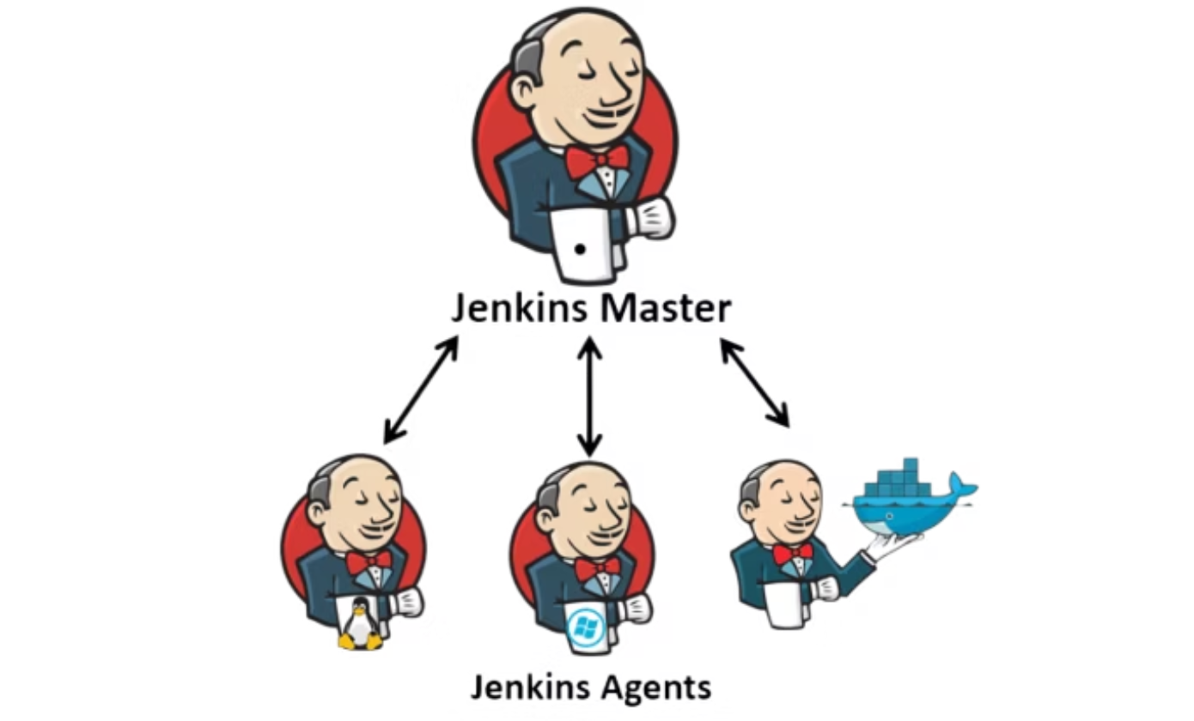

Jenkins Architecture
Controller (Master)
The brain of Jenkins. It schedules build jobs, manages plugins, and provides the user interface (UI) for configuration and monitoring.
Agents (Workers)
Execute the actual build tasks assigned by the Controller. They can be:Static: Always available and dedicated.Dynamic: Provisioned on-demand, often using Docker or Kubernetes for scalability.
Example: The Jenkins Controller might run on a central server, while agents run on multiple virtual machines or containers, distributed across different environments to handle diverse build requirements concurrently.

Slide 6
Installation & Setup
1
2
Install Jenkins Master
Plugin Management
Linux: Use apt-get install jenkins for Debian/Ubuntu systems.
Plugins extend Jenkins's functionality. Essential ones include:
Windows: Download and run the MSI installer.
Git Plugin: For integrating with Git repositories.
Docker: The quickest way is docker run -p 8080:8080 jenkins/jenkins:lts.
Pipeline Plugin: Enables defining build pipelines as code.
Blue Ocean Plugin: Provides a modern, user-friendly UI for pipelines.

Slide 7
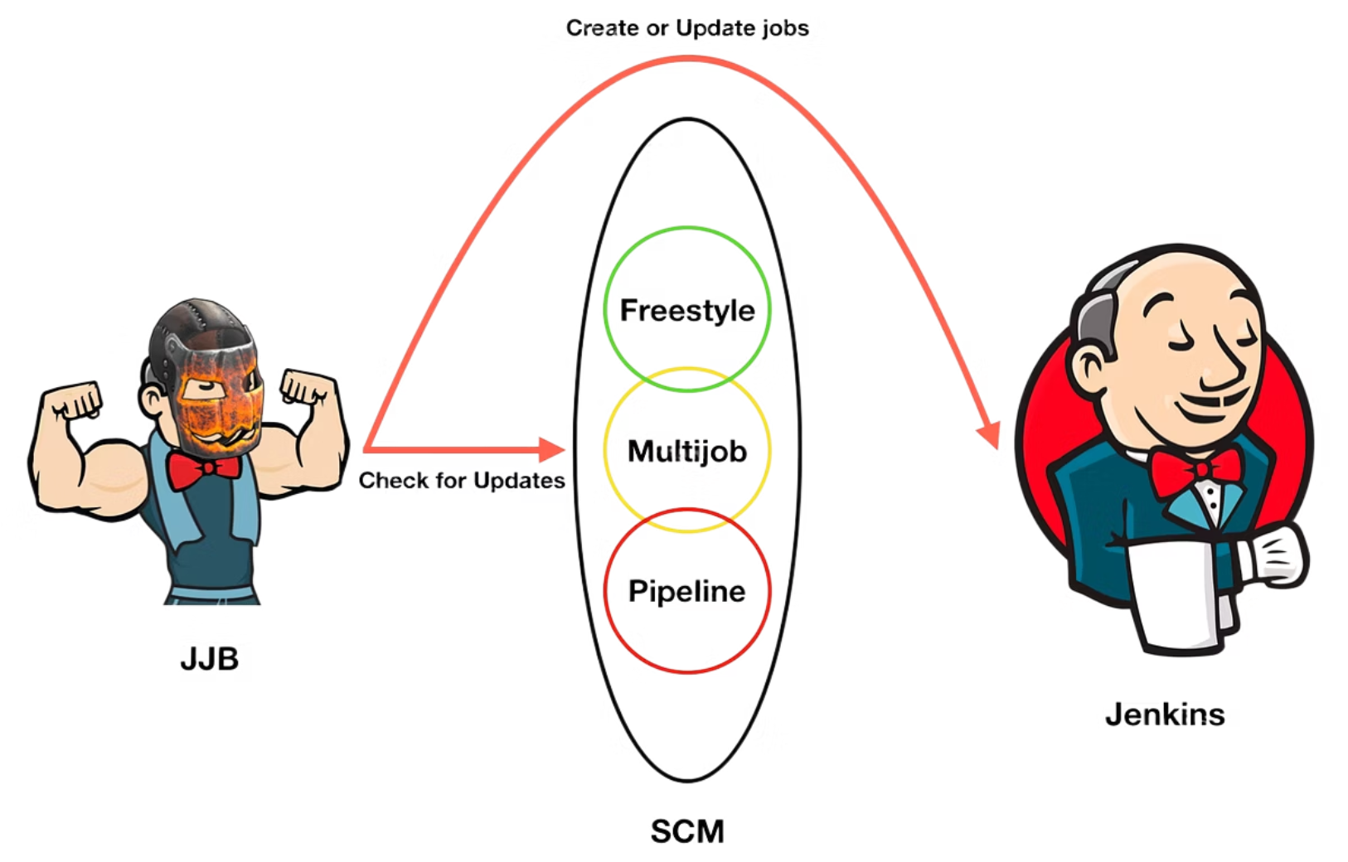

Jobs & Build Types
Freestyle Jobs: Simple, flexible jobs configured through the UI for basic build, test, or deployment tasks.
Pipeline Jobs: Define entire build workflows as code (Jenkinsfile) using Groovy, allowing for complex, multi-stage processes.
Multibranch Pipeline: Automatically discovers and creates build pipelines for branches and pull requests in your Git repository.
Example: A developer pushes code to a GitHub repository. A webhook triggers a Multibranch Pipeline job in Jenkins, which automatically builds and tests the new branch.

Slide 8

Build Triggers & Post-Build Actions
Triggers: What starts a build?
Post-Build Actions: What happens after a build?
SCM Polling: Jenkins periodically checks your Source Code Management (SCM) for changes (e.g., * * * * * for every minute).
Notifications: Send email or Slack notifications about build status (success/failure).
Artifact Archiving: Store build outputs (e.g., JAR files, deployment packages) for later use or deployment.
GitHub Webhook: An instant notification from GitHub to Jenkins when a change is pushed, triggering a build.
Execute Shell Commands: Run custom scripts post-build, such as deploying to a staging server.
Cron Schedules: Builds scheduled at specific times (e.g., daily builds at midnight).

Slide 9
First Hands-On (Demo)
Let's create a basic Freestyle Job to see Jenkins in action:
01
02
1. Create New Item
2. Link GitHub Repo
From the Jenkins dashboard, click "New Item" and select "Freestyle project."
In the job configuration, under "Source Code Management," select Git and enter your GitHub repository URL.
03
04
3. Add Build Step
4. Build & Verify
Under the "Build" section, add a build step "Execute shell" and type echo "Hello Jenkins!".
Save the job, then click "Build Now." Check the "Console Output" to see your message.
Don't forget to install Blue Ocean for a more intuitive and visually appealing pipeline visualisation.

Slide 10

Simple Jenkins Pipeline Example
Pipelines are defined in a Jenkinsfile stored in your repository, enabling "Pipeline as Code." Here's a basic Declarative Pipeline:
pipeline {
agent any
stages {
stage('Build') {
steps {
echo 'Building the application...'
}
}
stage('Test') {
steps {
echo 'Running tests...'
}
}
stage('Deploy') {
steps {
echo 'Deploying to server...'
}
}
}
}
This pipeline consists of three main stages: Build, Test, and Deploy.
`agent any`: Specifies that the pipeline can run on any available Jenkins agent.
Steps: Each stage contains steps that define the actions to be executed.
Example: When new code is pushed to Git, Jenkins automatically detects the Jenkinsfile and executes this defined pipeline, ensuring a consistent and automated workflow from build to deployment.

Slide 11
Adding and Managing Agents in Jenkins
Why Jenkins Agents?
Scalability – Run builds on multiple servers in parallel.
Isolation – Different environments (Linux, Windows, Docker, EC2).
Performance – Offload heavy jobs from Jenkins Controller.
Flexibility – Run specific jobs on specific nodes (e.g., Java builds on Linux, .NET builds on Windows).
Key Idea: Controller = Brain, Agents = Workers.

Slide 12
Pre-Requisites to add a Linux Agent
On the Jenkins Agent (via Terminal)
Install Java: SSH into the agent and install Java if not already present. Verify with java --version.
Create a Jenkins User: Create a dedicated user (e.g., 'jenkins') for running agent processes. This user should have a home directory (e.g., /var/lib/jenkins or /home/jenkins). Add it to a group like 'wheel' for sudo access if needed.
Generate SSH Key Pair: Switch to the jenkins user and generate keys.
Copy the Private Key: Display the private key for later use in Jenkins.
On the Jenkins Master (via UI):
Add SSH Credentials:
Go to Dashboard > Manage Jenkins > Credentials > System > Global credentials (unrestricted) > Add Credentials.
Kind: SSH Username with private key.
Scope: Global.
ID: Something like 'jenkins-agent-ssh'.
Description: Descriptive text.
Username: jenkins.
Private Key: Select "Enter directly" and paste the private key copied from the agent.
Passphrase: Leave blank if none set.
Click OK.

Slide 13
How to Add an Agent (Steps)
Go to Manage Jenkins -> Nodes and Clouds -> New Node.
Enter Node Name & choose “Permanent Agent.”
Configure:
Remote Root Directory (e.g., /home/jenkins)
Labels (to target specific jobs)
Number of executors
Select Launch Method:
SSH (Linux/EC2 builds)
JNLP (Windows nodes)
Save
Jenkins shows agent connection instructions.

Slide 14
Assigning Pipelines to Agents
pipeline {
agent { label 'linux-agent' }
stages {
stage('Build') {
steps {
echo 'Building the application on EC2 agent...'
}
}
stage('Test') {
steps {
echo 'Running tests on EC2 agent...'
}
}
stage('Deploy') {
steps {
echo 'Deploying from EC2 agent to server...'
}
}
}
}
This pipeline consists of three main stages: Build, Test, and Deploy.
`agent { label 'linux-agent' }`: Specifies that the pipeline will run on the Jenkins agent with label ‘linux-agent’
Steps: Each stage contains steps that define the actions to be executed.

Slide 15
Pipeline 1: Freestyle Job (Basic Automation)
Objective: Show Jenkins automation with a simple task (no code build).
Use Case: Automate a daily system check script
Steps:
Create a Freestyle Job named System-Check.
Configure a Build Step -> Execute Shell
Script example:
echo "Running system health check...“
Uptime
free –m
df –h
echo "Health check completed.“
Run the job
Check Console Output

Slide 16
Pipeline 2: Declarative Pipeline (Basic CI/CD for Python App)
pipeline {
agent any
stages {
stage('Checkout') {
steps {
git branch: 'main', url: 'https://github.com/aryanm12/TravelMemory.git'
}
}
stage('Install') {
steps {
sh 'cd backend; npm install'
}
}
stage('Build') {
steps {
sh 'cd backend; npm run build'
}
}
}
}
Objective: Demonstrate a basic CI/CD pipeline for a small Python project.
Use Case: Build -> Test -> Deploy (copy to staging folder).
Setup:
Use a simple Python project from GitHub (e.g., a “Hello Flask API” or “Math functions with tests”).
Include a requirements.txt and pytest tests.
Steps:
Create a Pipeline using the Jenkinsfile provided here
Demo Flow:
Push a code change (e.g., update Python function).
Jenkins auto-triggers build.
Pipeline runs -> checkout -> install -> test -> package -> deploy.
Verify in console logs and check /tmp/deploy.

